Slide 1
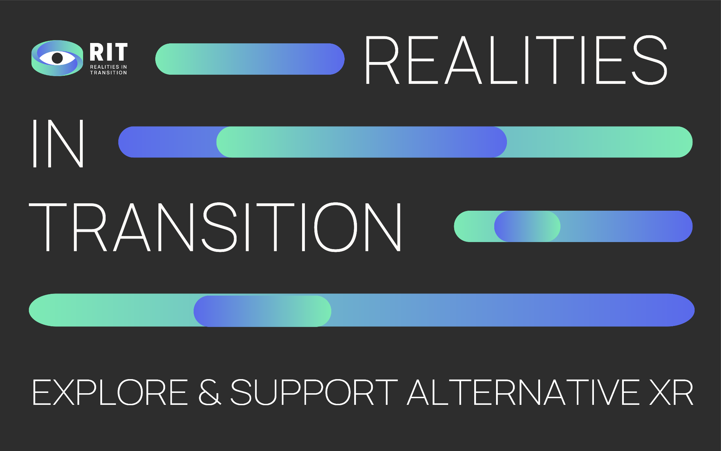

Slide 2

WHAT IS REALITIES IN TRANSITION ?

Slide 3



RiT is an international community that aims at both exploring and supporting alternative Extended Reality (XR) productions, and experiment new narratives and creative processes.
RiT aims at building a strong, independent European XR creative and activist community, a think tank to tackle current and future challenges in the digital sector.

Slide 4
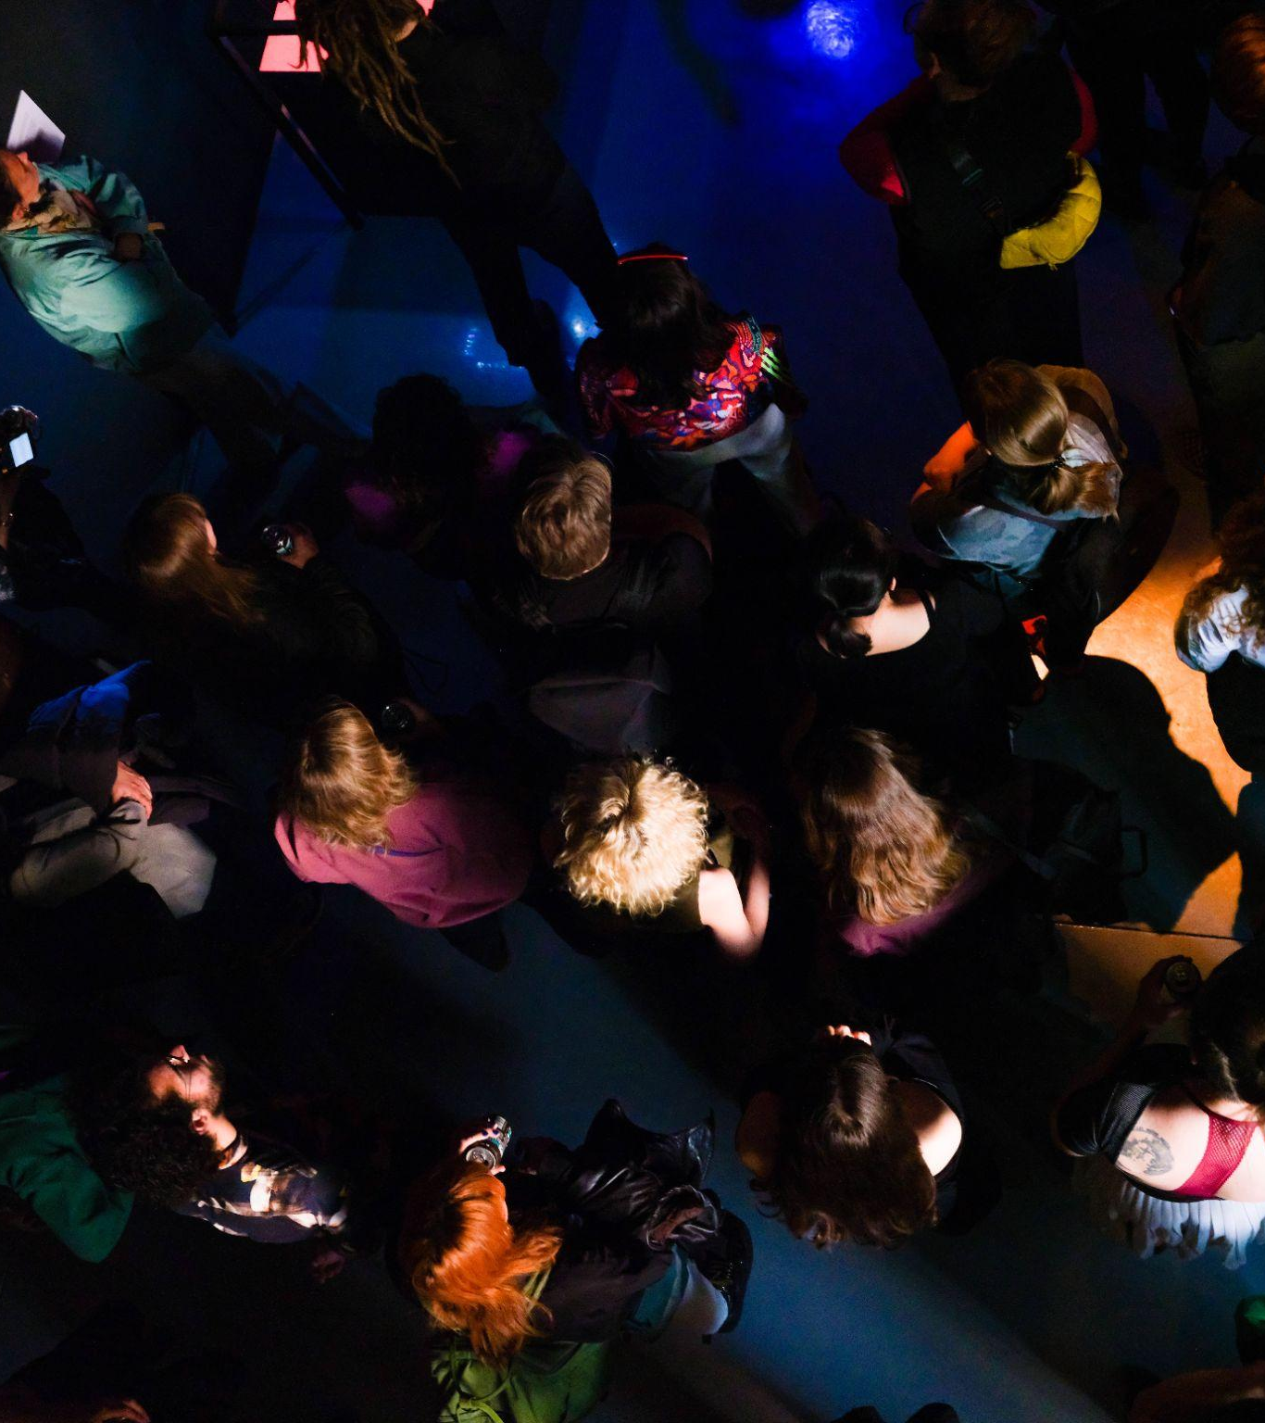
THE EUROPEAN XR COMMUNITY
RiT aims at building an European XR community, composed of emerging artists, experts and mentors who want to reflect on and promote a sustainable, open and inclusive XR.
V2 Event Test_LAB: Realities in Transition 2023, Rotterdam

Slide 5
WHO ARE WE?

Slide 6





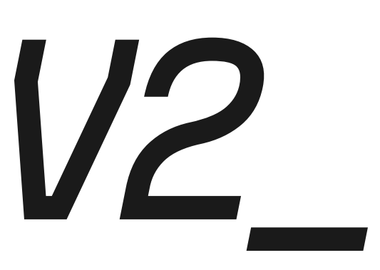

Bruxelles (BE)
Linz (AT)
Marseille (FR)
Zagreb (CR)
Marseille (FR)
Rotterdam (NL)
Gijón (ES)

Slide 7
L.E.V. (Laboratorio de Electrónica Visual) is a platform of production, promotion and experimentation related to electronic sound creations, audiovisual creations and digital art.
https://vimeo.com/782436455

Slide 8
WHAT DO WE DO?

Slide 9
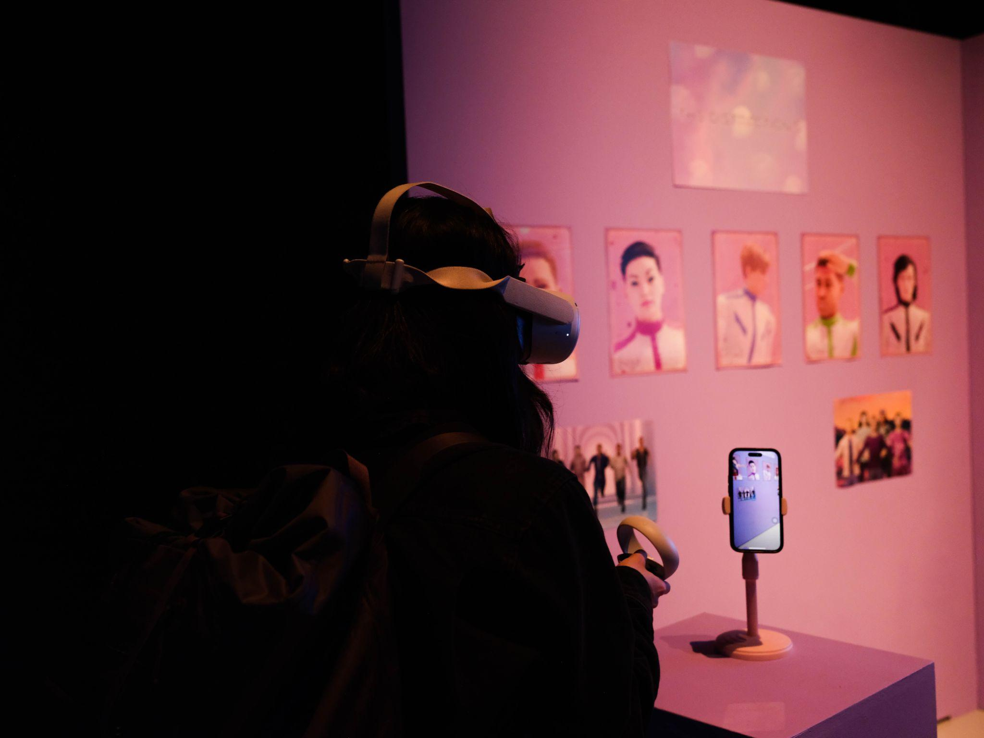
Establishing XR as a sustainable, inclusive tool for the common good.
“The Distraction 5” by Studio Comrades, V2, Test_LAB: Realities in Transition 2023, Rotterdam

Slide 10
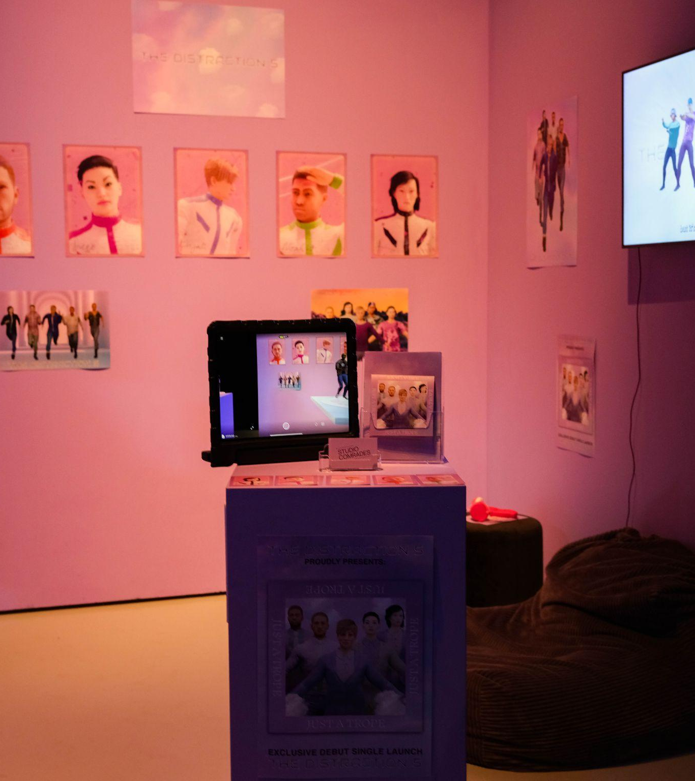
RiT wants to consolidate and share XR related knowledge, tools and methodologies.
RiT takes a critical look at XR, bringing together creation, curation and dissemination practices with education methods, privacy, ethics and sustainability issues.
“The Distraction 5” by Studio Comrades,
V2, Test_LAB: Realities in Transition 2023, Rotterdam

Slide 11
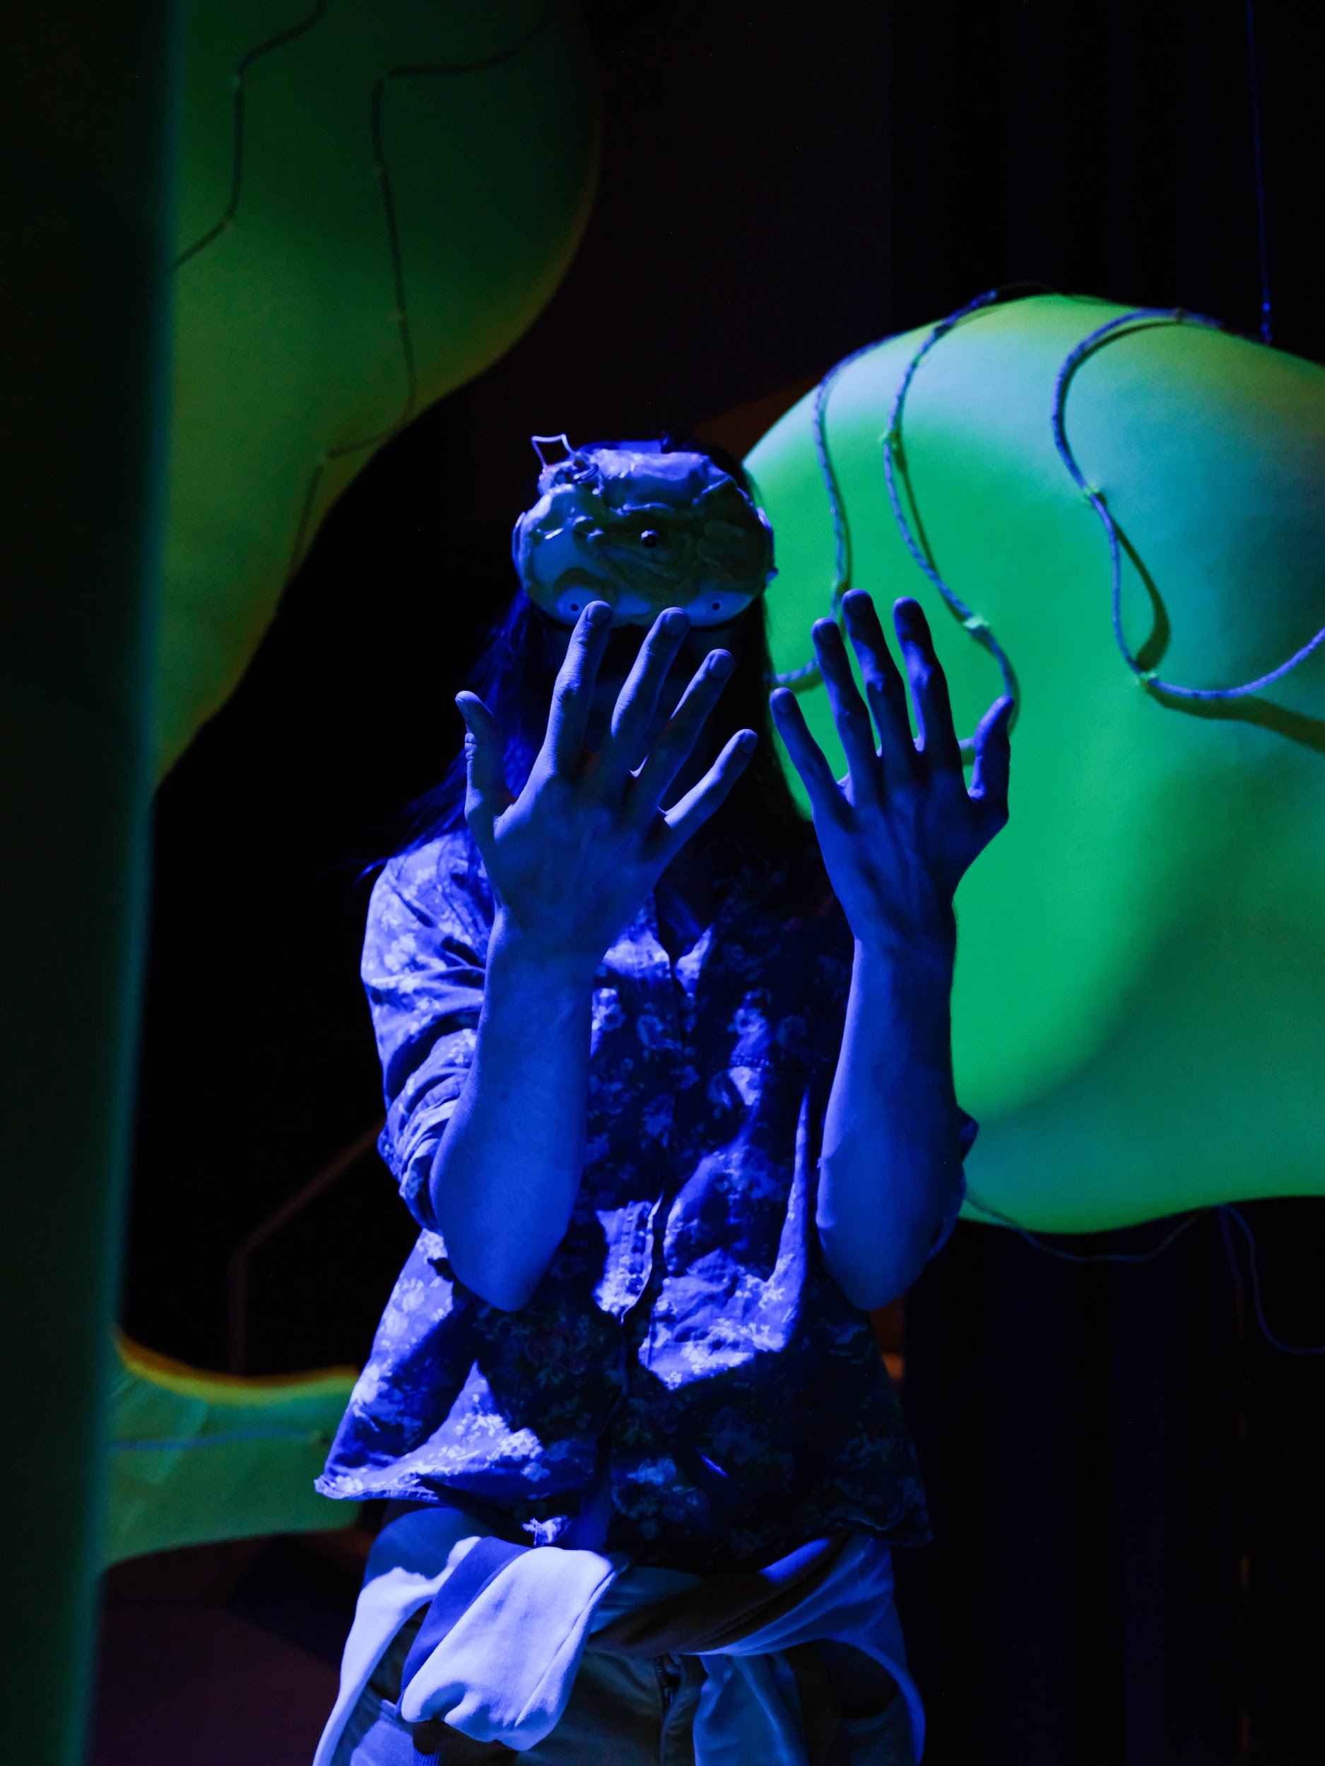
Supporting alternative XR creation to explore new narratives.
“The Collective Algorithm of Care” by Leo Scarin & Marlot Meyer, V2, Test_LAB: Realities in Transition 2023, Rotterdamc

Slide 12
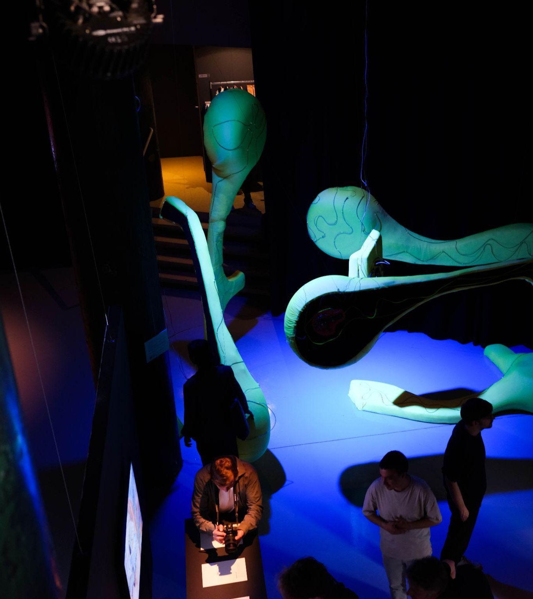
RiT wants to be a major actor in the XR sector, exploring new narratives and creative processes and inspiring the whole community.
Realities in Transition supports emerging XR creatives, artists and projects to incorporate common and open source methodologies as well as inclusive and sustainable practices into experimental XR creations.
V2 Event Test_LAB: Realities in Transition 2023, Rotterdam

Slide 13
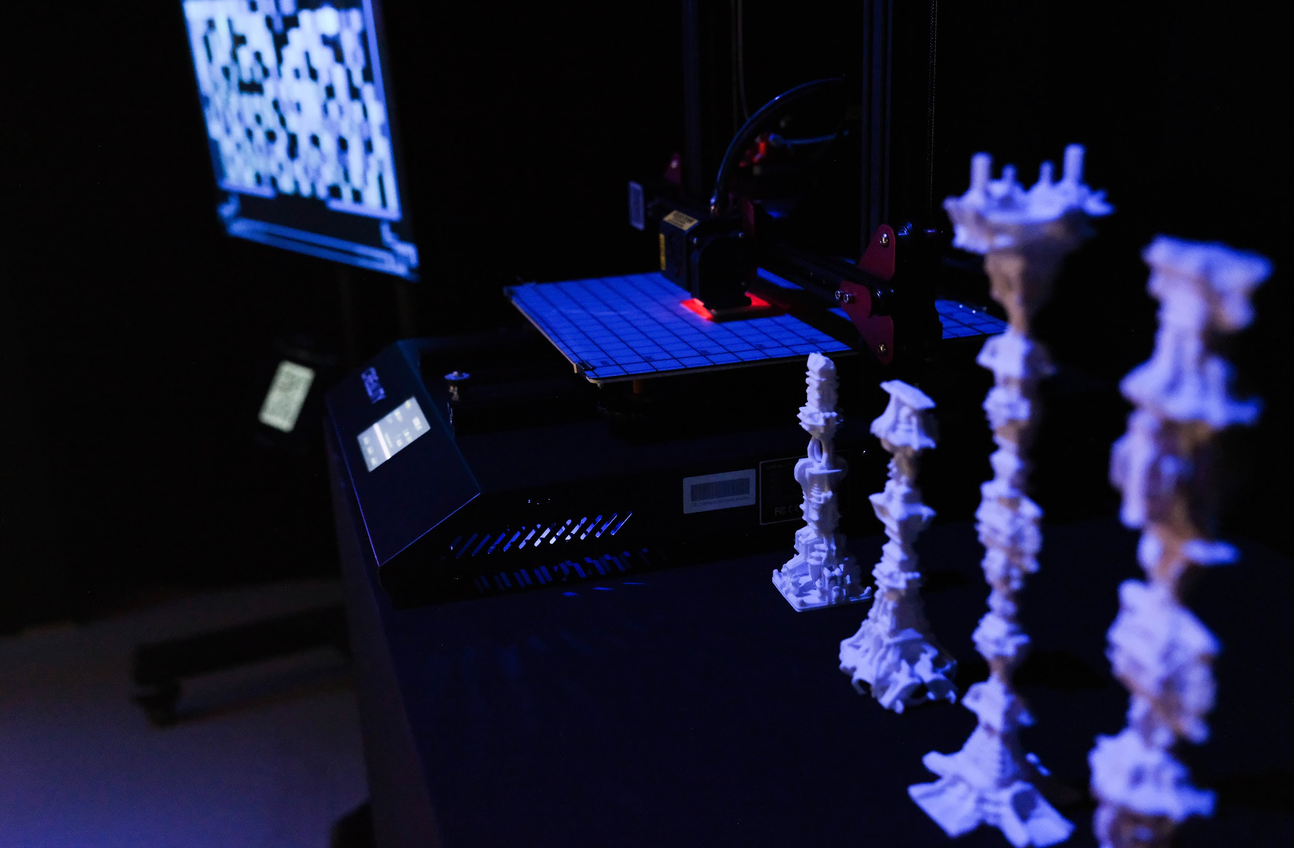
Consolidating the existing XR creative community.
“Binary Deconstruction” by InDialog Studio , V2, Test_LAB: Realities in Transition 2023, Rotterdam

Slide 14
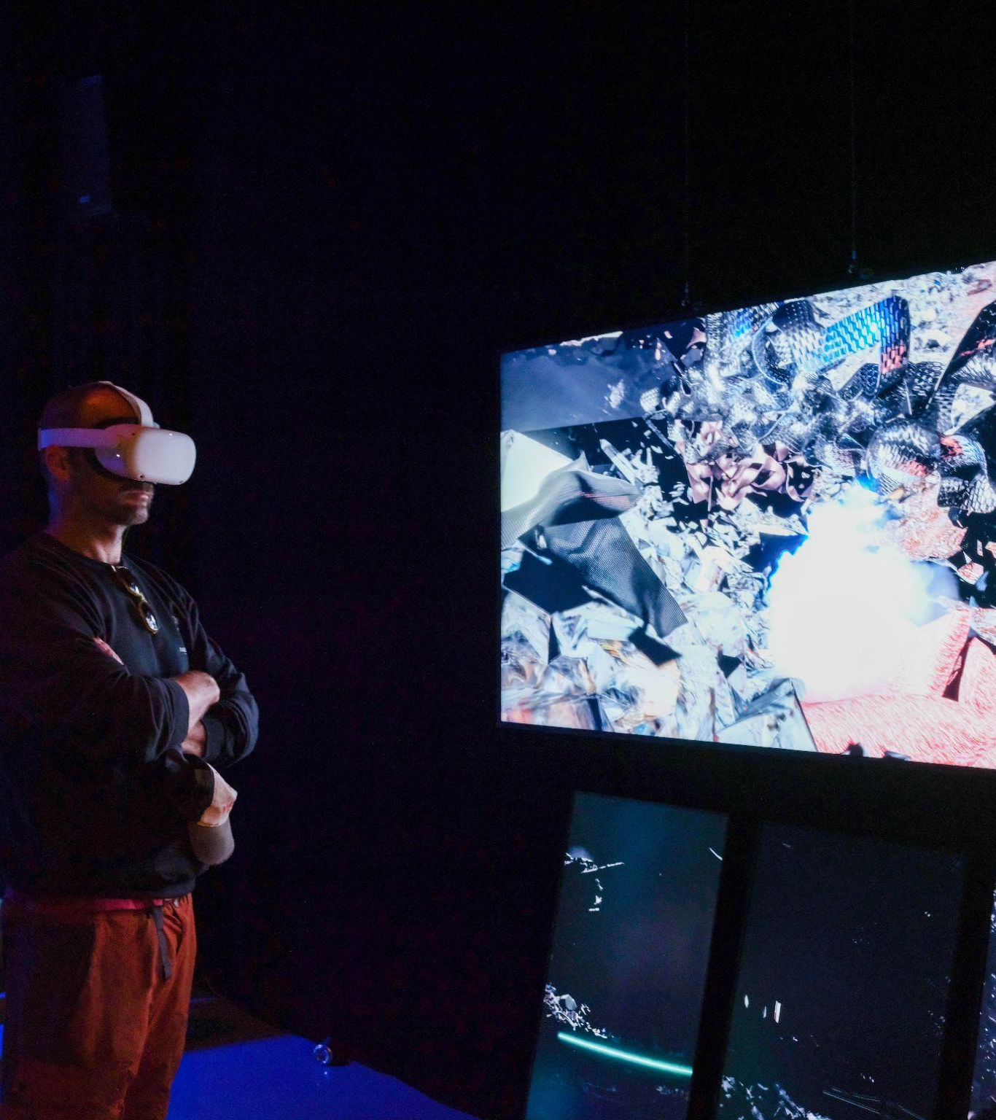
RiT creates opportunities for networking and peer-to-peer learning between independent and activist XR initiatives, XR artists and researches, decision-makers, and the general public.
RiT wants to bring together these stakeholders on topics such as how to use XR as a common, open and sustainable tool in their work.
RiT is also a hub for existing independent and activist XR initiatives and promotes them, giving artists recognition at European level.
V2 Event Test_LAB: Realities in Transition 2023, Rotterdam

Slide 15
XR LABS & WORKSHOPS

Slide 16
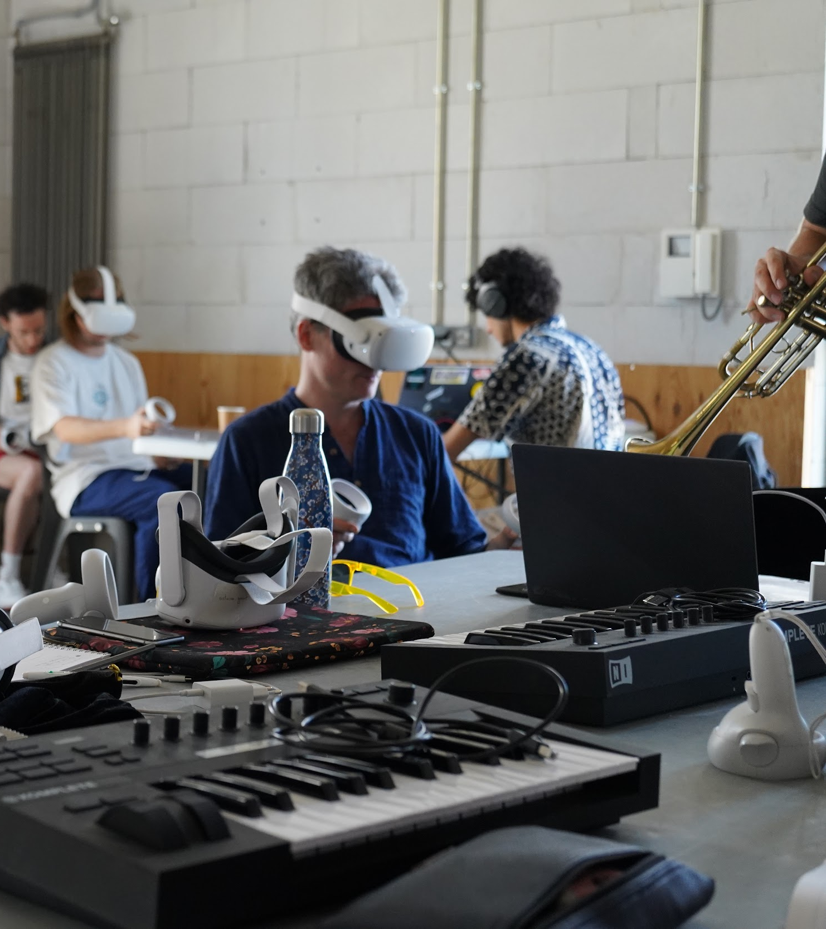
WHY?
To transmit open source technical, cultural and critical thinking tools for XR.
To engage members of the Creative and Activist European XR community, at a European level.
FOR WHOM?
Local students and young creators.
Chroniques Campus, 2023

Slide 17
RESIDENCIES

Slide 18
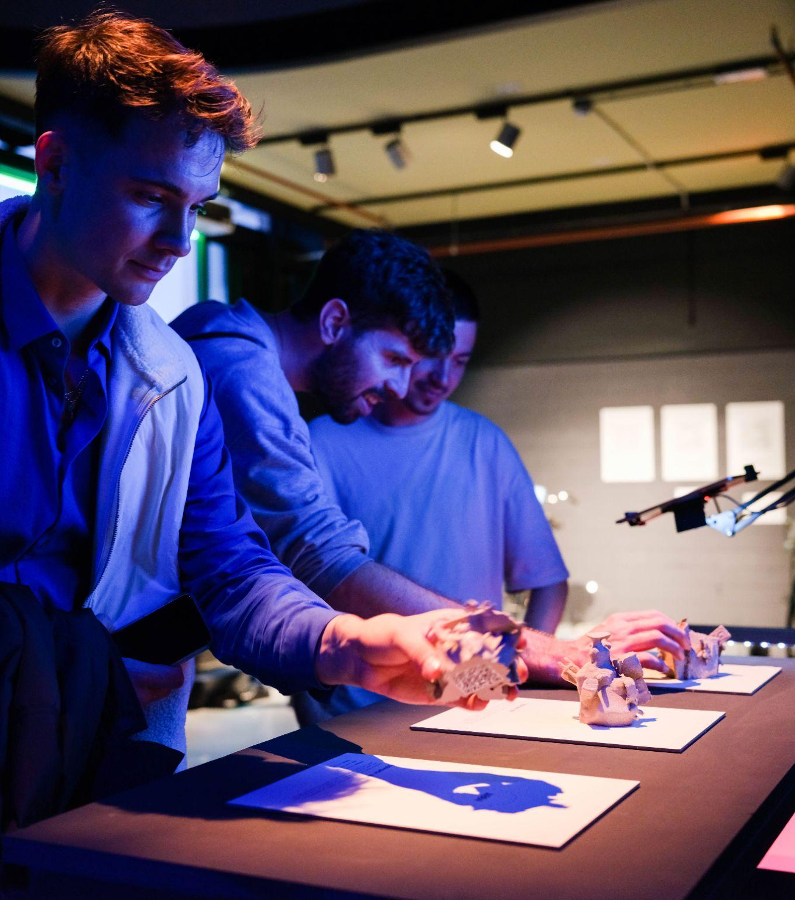
For 22 weeks, 17 emerging creators are supported by the RiT project during their artistic process.
Through 3 international calls, RiT encourages inclusive and sustainable projects.
The artworks are then showcased in different exhibitions, fairs and festival supported by RiT.
“What a Mess” by Hugo Pilates & Pedro Gil Farias
V2, Test_LAB: Realities in Transition 2023, Rotterdam

Slide 19
EUROPEAN XR CAMPS

Slide 20
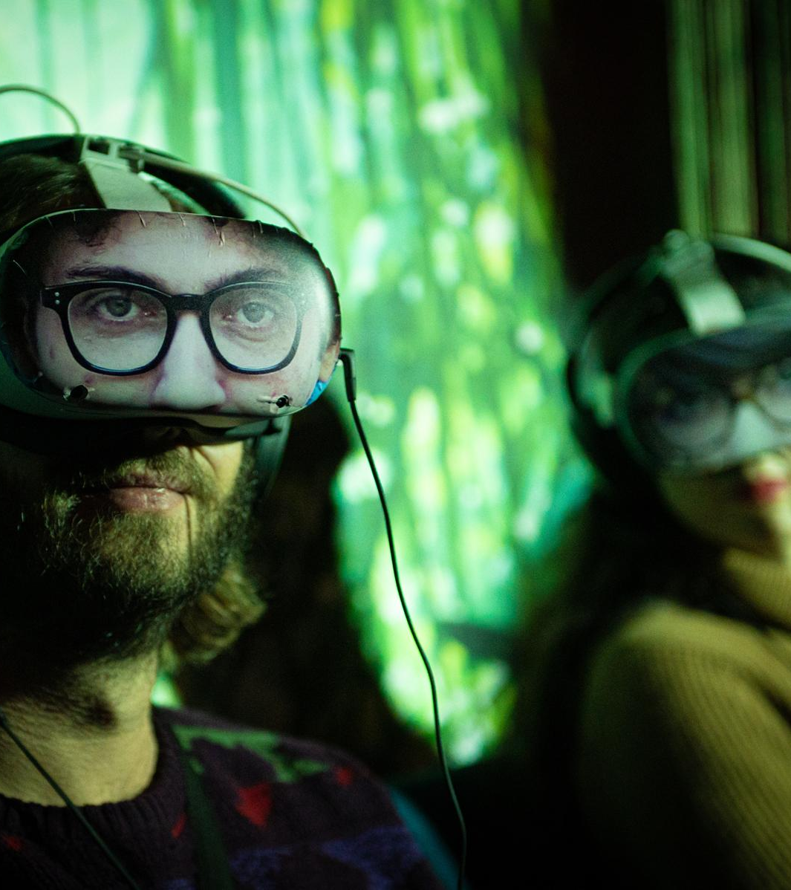
Through networking activities, peer-to-peer learning workshops, conferences and hackathons, the XR Camps bring together the Creative and Activist European XR community every year.
The Camps are also the occasion to gather the community around artistic exhibition and performances of XR projects.

Slide 21
EUROPEAN XR
MANIFESTO

Slide 22
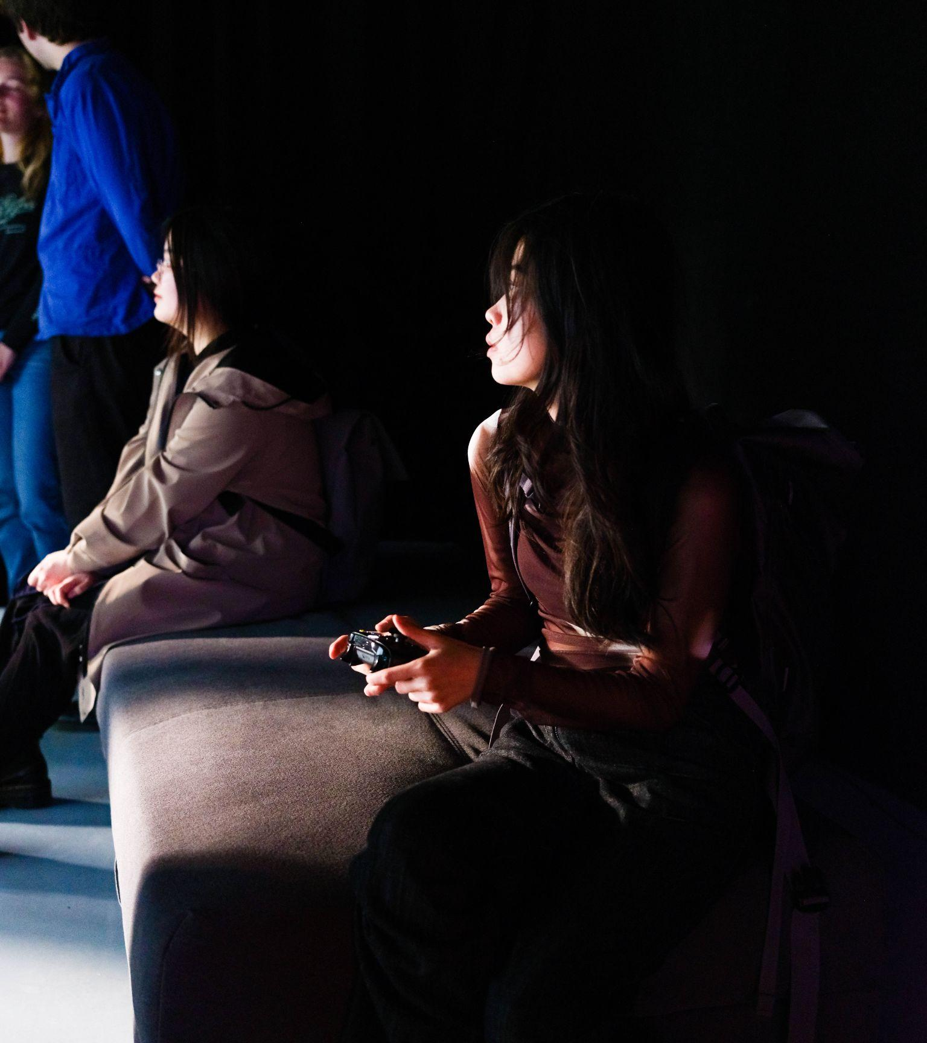
The European XR manifesto is a statement of the values, principles, beliefs and mission of the Creative and Activist European XR community.
V2 Event Test_LAB: Realities in Transition 2023, Rotterdam

Slide 23

HACKATHON
Recycling the AI

Slide 24
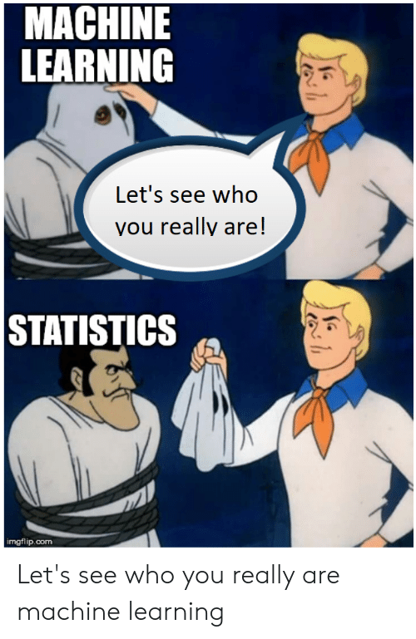
What do you know or what have you heard about Artificial Intelligence and machine learning?

Slide 25
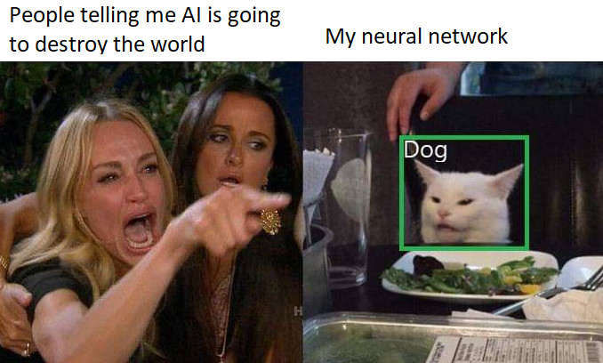
Is Artificial Intelligence really going to destroy the world?

Slide 26
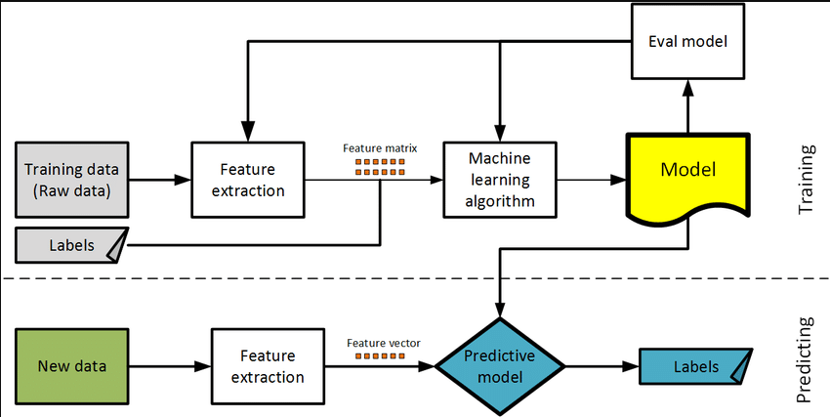
Spoiler alert! AI is just a tool

Slide 27
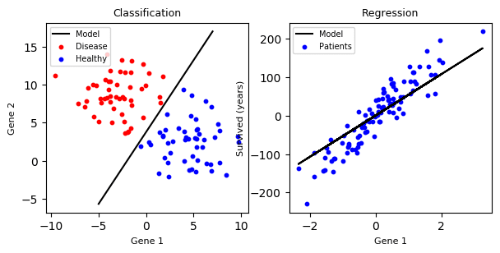
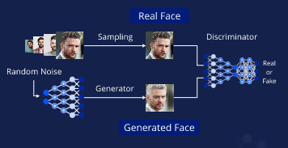
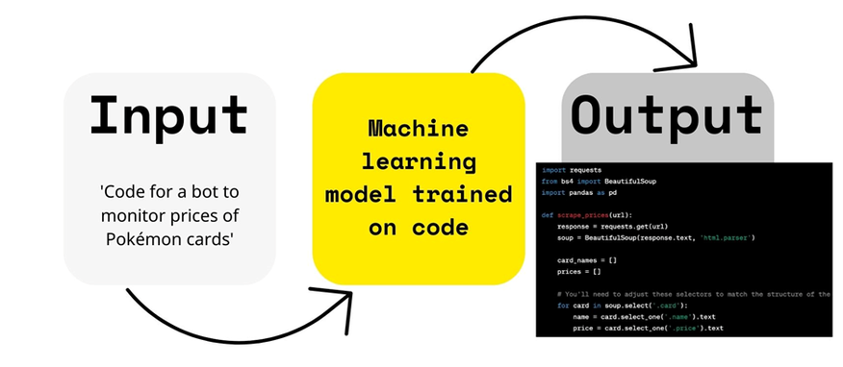
What kind of things can the AI do?

Slide 28
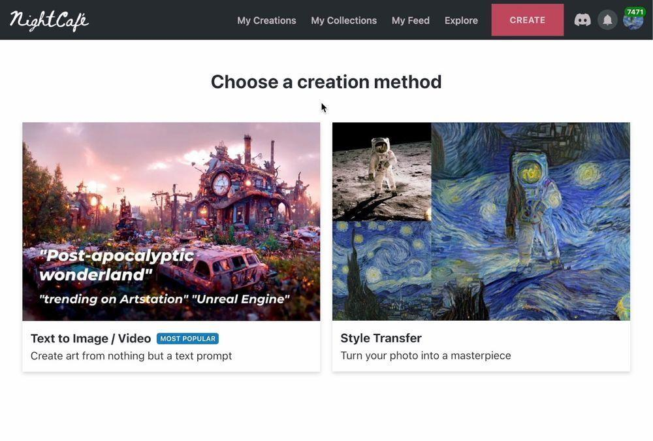
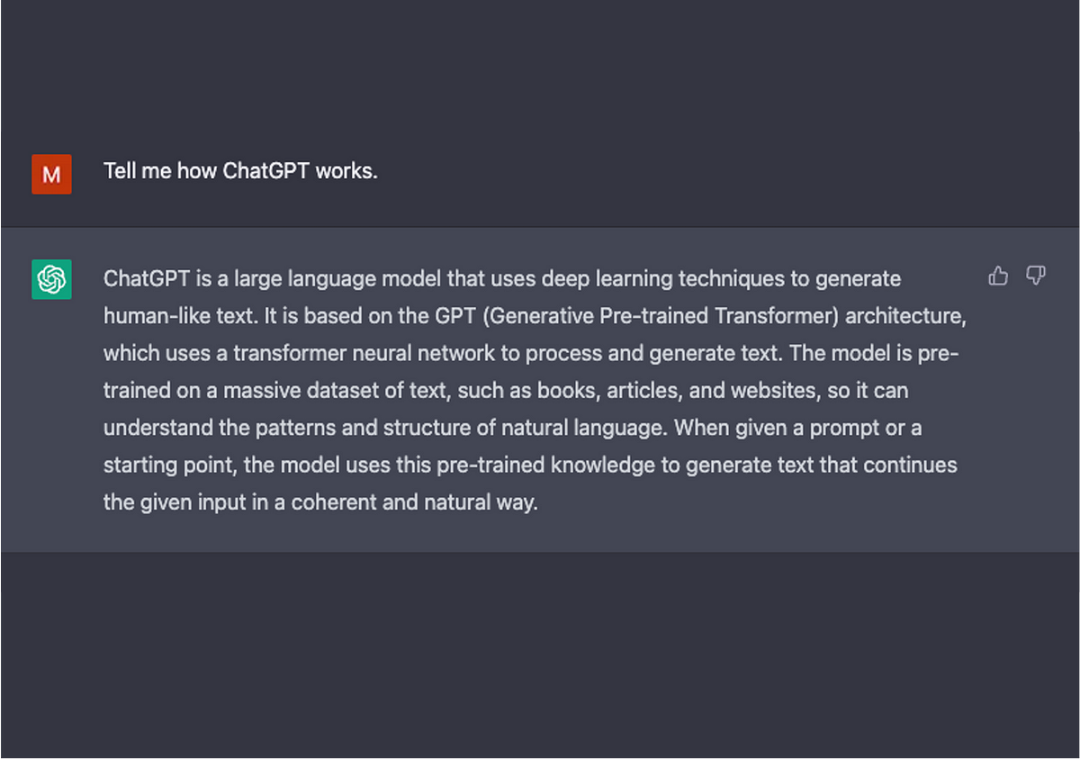
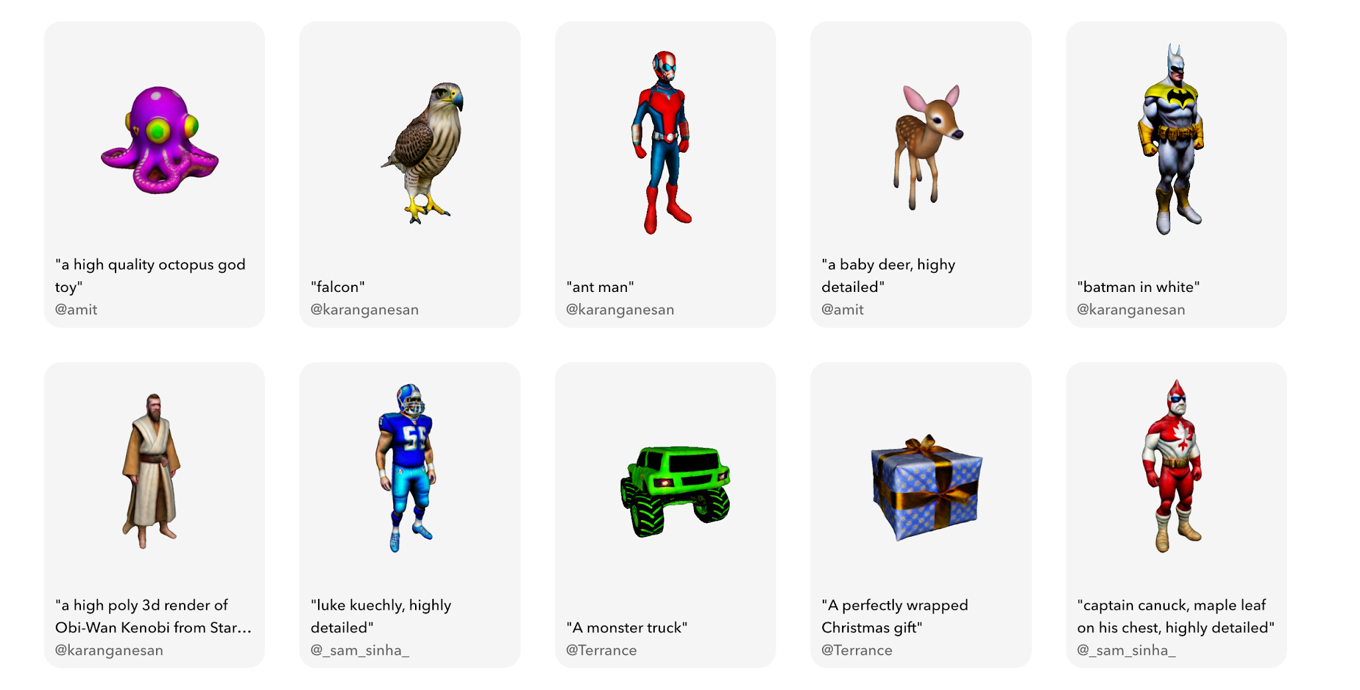
Text to image
Language models
Text to 3d models
…

Slide 29
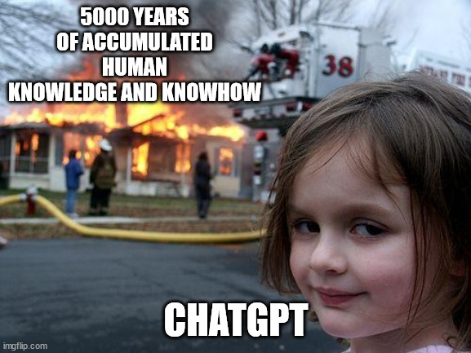
How do the AI’s know so much?

Slide 30
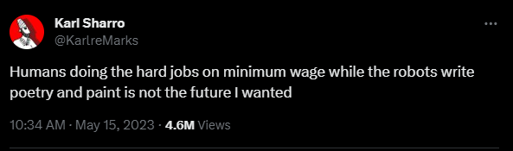
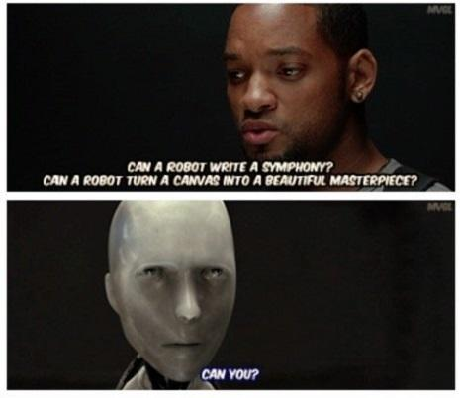
What kind of things should the AI do?

Slide 31

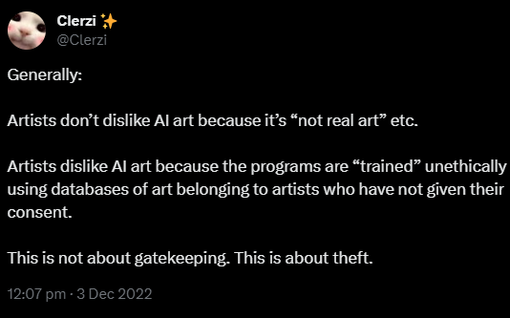
What kind of things should not the AI do?

Slide 32
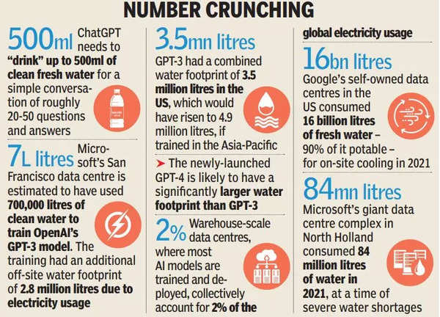
But this is not the only problem of AI and all digital and data driven technologies.

Slide 33
So, what do we do with all the existing AI generated content?

Slide 34
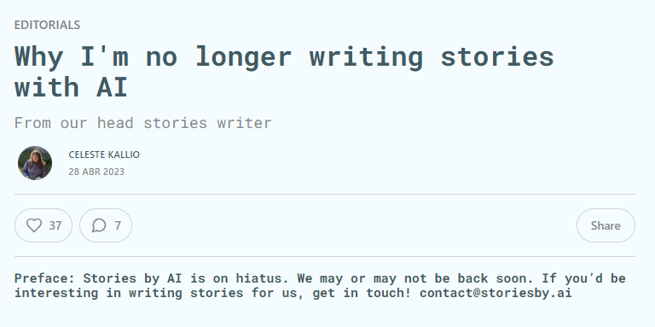
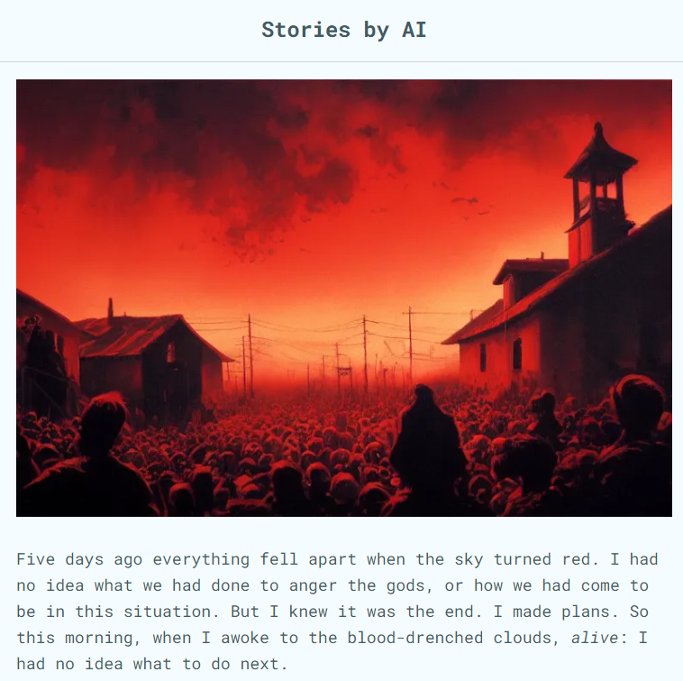
We will begin reading one of the selected stories from the closed project Stories by AI.

Slide 35

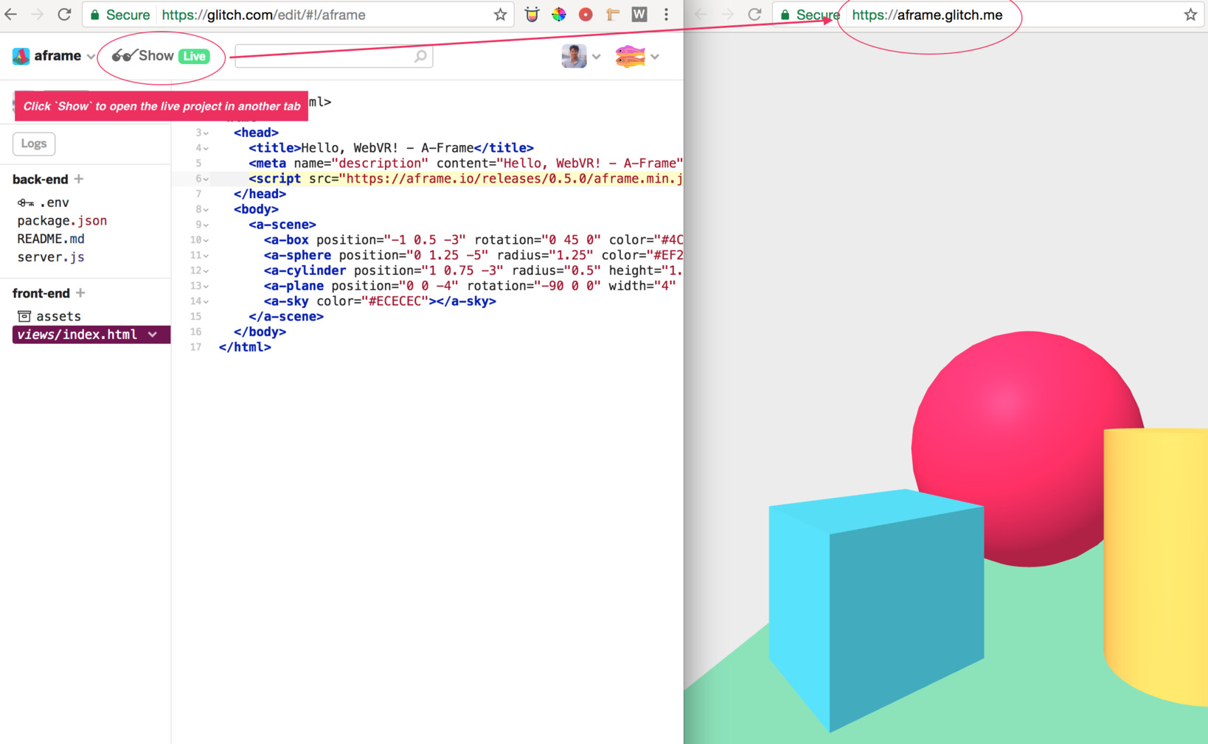
We will create a VR scene using an HTML open source library called A-Frame based on the story

Slide 36
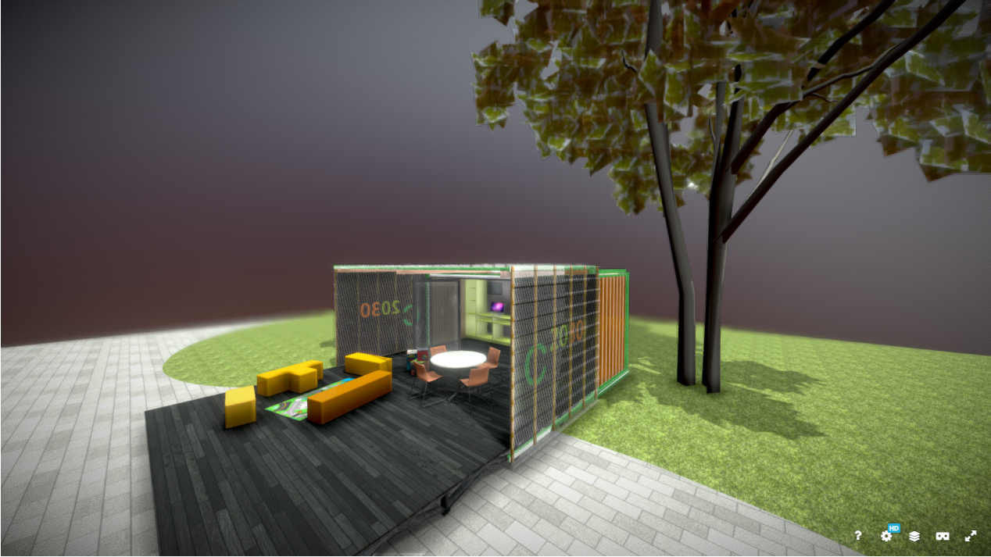
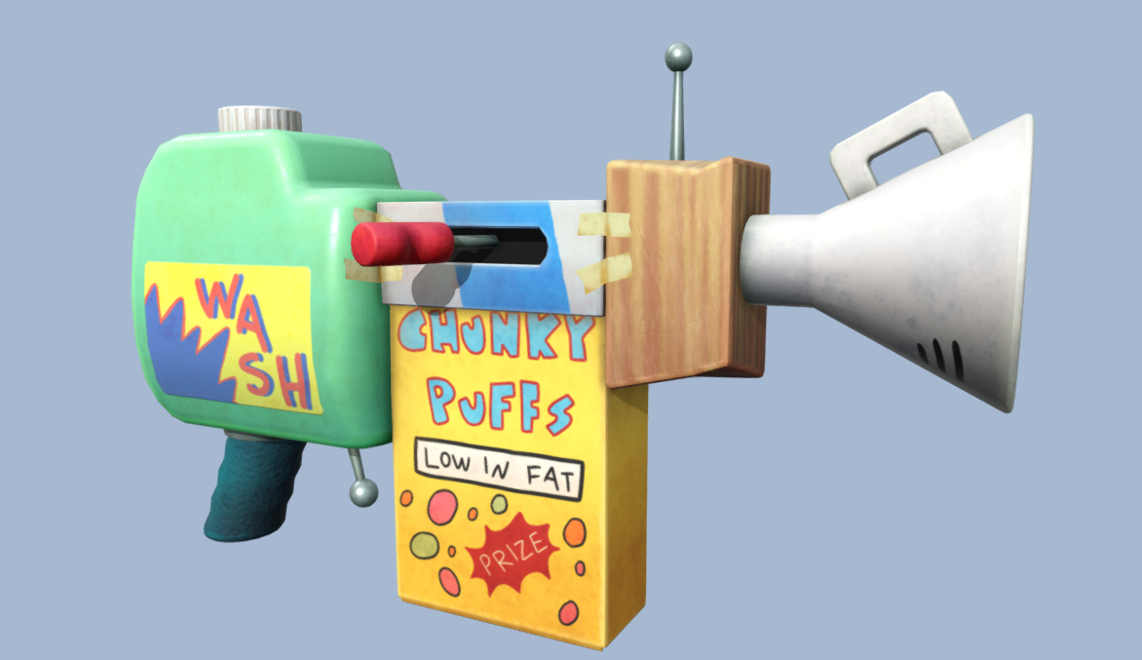
We will fill the scene by recycling AI (and non AI but free) generated content from various websites.

Slide 37
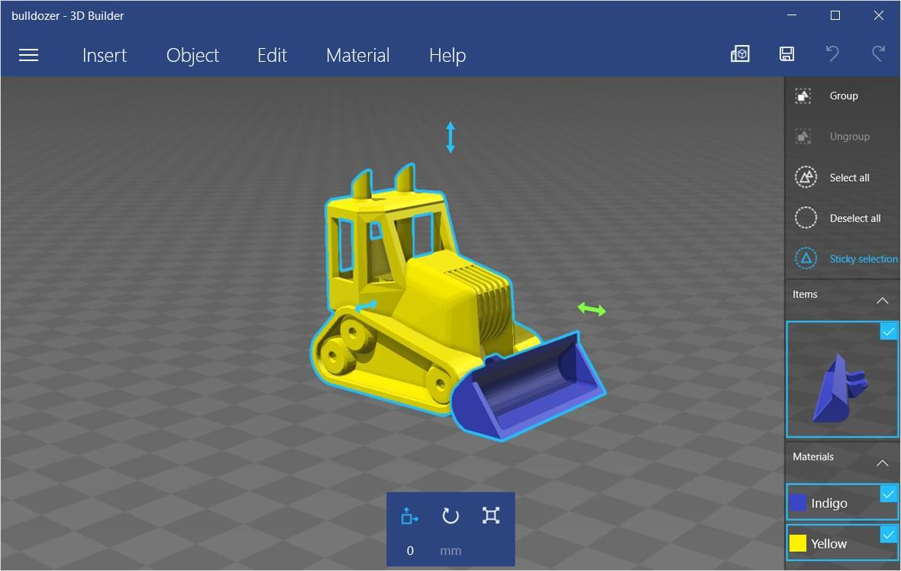
If needed, we will edit those 3d models on 3D Builder in order to repurpose them for our scenes.

Slide 38

Simple advices:
Don’t wait to be told what to do.
Split the tasks into the group.
If stuck in a problem ask for help but while it arrives search in google.
Relax and enjoy the ride.

Slide 39

Let’s begin!

Slide 40
Max, the plant whisperer
The underground world of plant collecting
The gift of a bird’s song
The greatest goddamn hero I have ever known
The hellmouth in the coffee shop
When the sky turned red

Slide 41
1st Workshop
Basic A-frame tags, create a scene, movement and camera. Basic objects

Slide 42
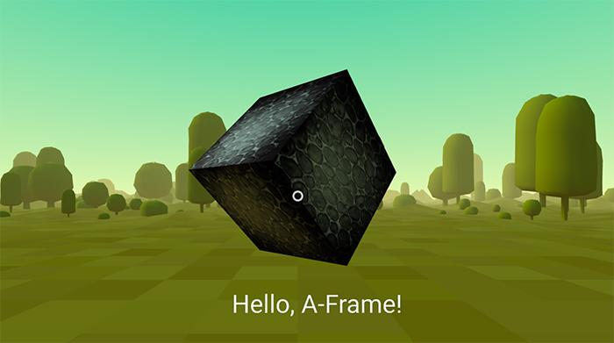
Basic HTML is code written between tags.
Tags are special words inside < and > characters.
Most tags are double. Which means you need two of them, one for open like <html> and another to close </html>.
Between tags there are more tags in a tree-like structure.
<html> </html>

Slide 43
<a-scene> tag

Slide 44
<html> <head> <script src="https://aframe.io/releases/1.4.0/aframe.min.js"></script> </head> <body> <a-scene> </a-scene> </body> </html>
A-Frame websites, like every website, have a <head> and a <body> tags.
Inside <head> we place stuff needed to make the page work, like the <script> tag that gave us A-Frame capabilities.
Other tags inside <head> are <title> or <meta>.
Inside the <body> tag we need to place our 3D objects, inside a <a-scene> tag.

Slide 45
<a-scene> <a-box color="#666666" position="0 2 -5" rotation="0 45 45" scale="2 2 2"> </a-box> </a-scene>
The <a-scene> tag handles all the needed setup for 3d scenes.
There are some basic 3D objects, like <a-box>.
Others are: <a-plane>, <a-sky>, <a-torus-knot>, <a-sphere>, <a-cylinder> and <a-cone>
They all share the properties: color, position (x, y, z), rotation (x, y, z) and scale (x, y, z).
It is possible to add many objects to a <a-scene>. One, after the other.

Slide 46
<a-assets> <img id="grass" src="images/grass.jpg"/> </a-assets> <a-plane material="src: #grass; repeat:10 10; transparent: true; opacity: 0.75"> </a-plane>
Images are used mainly to add texture to an object. Then they are called materials.
They have specific properties. Some of the most important are:
src: identification.
repeat: number of repetitions to cover the surface.
transparent: true or false.
opacity: percentage of transparency.
Take care of the size of your images.

Slide 47
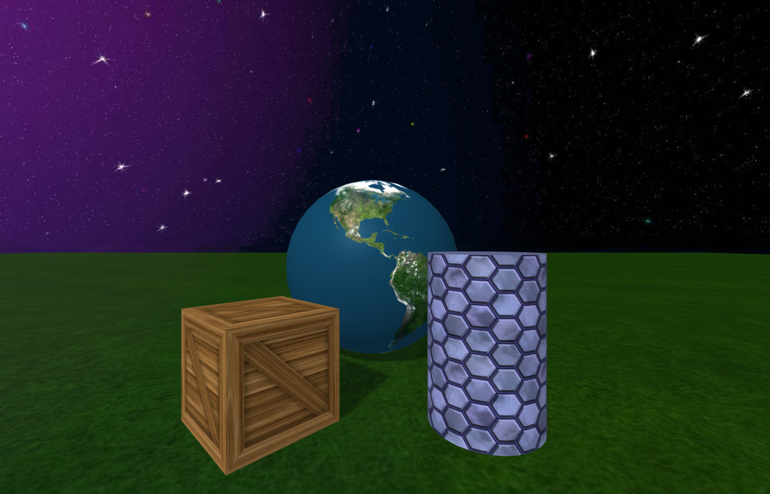
Images are used mainly to add texture to an object. Then they are called materials.
They have specific properties. Some of the most important are:
src: identification.
repeat: number of repetitions to cover the surface.
transparent: true or false.
opacity: percentage of transparency.
Take care of the size of your images.

Slide 48
Crtl + Alt + i for Inspector

Slide 49
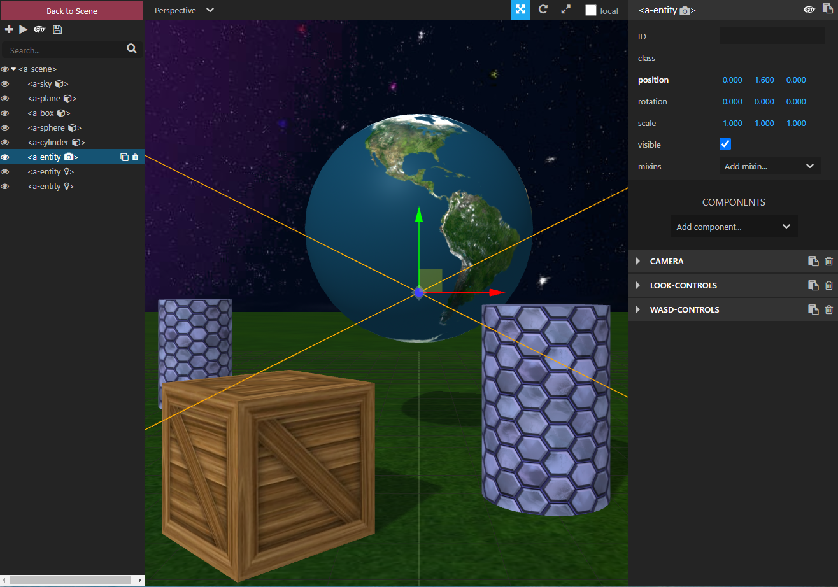
To ease the composition of a scene, A-frame comes with a tool called Inspector.
To see it in action, go to image-texture.html and hit
Ctrl + Alt + i

Slide 50
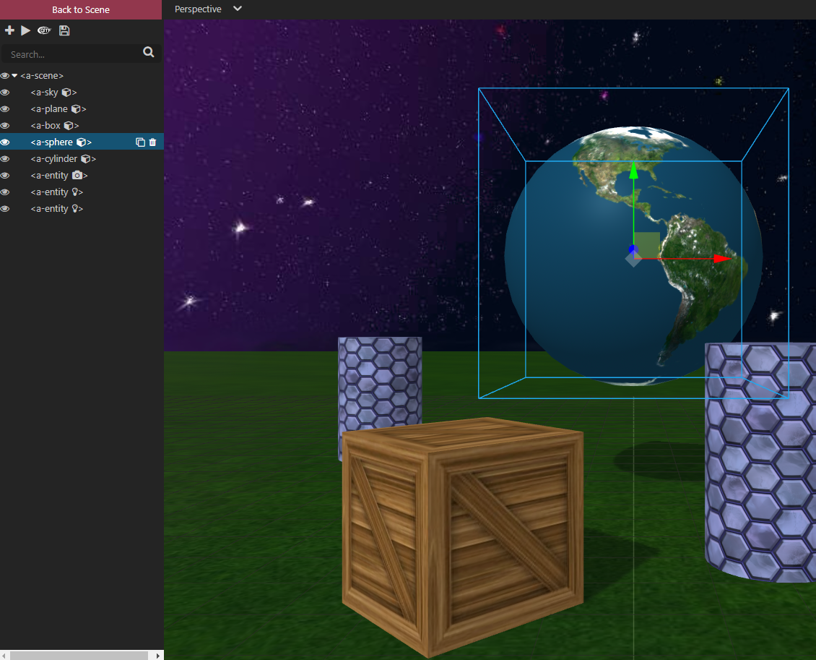
The menu on the left allows you to select the objects already present in the <a-scene> tag.
It allows you to move them using the green, red and blue arrows on every selected object.
You can also change the view to help you see in the three dimensions with number keys 1, 2, 3, 4 and 5.

Slide 51
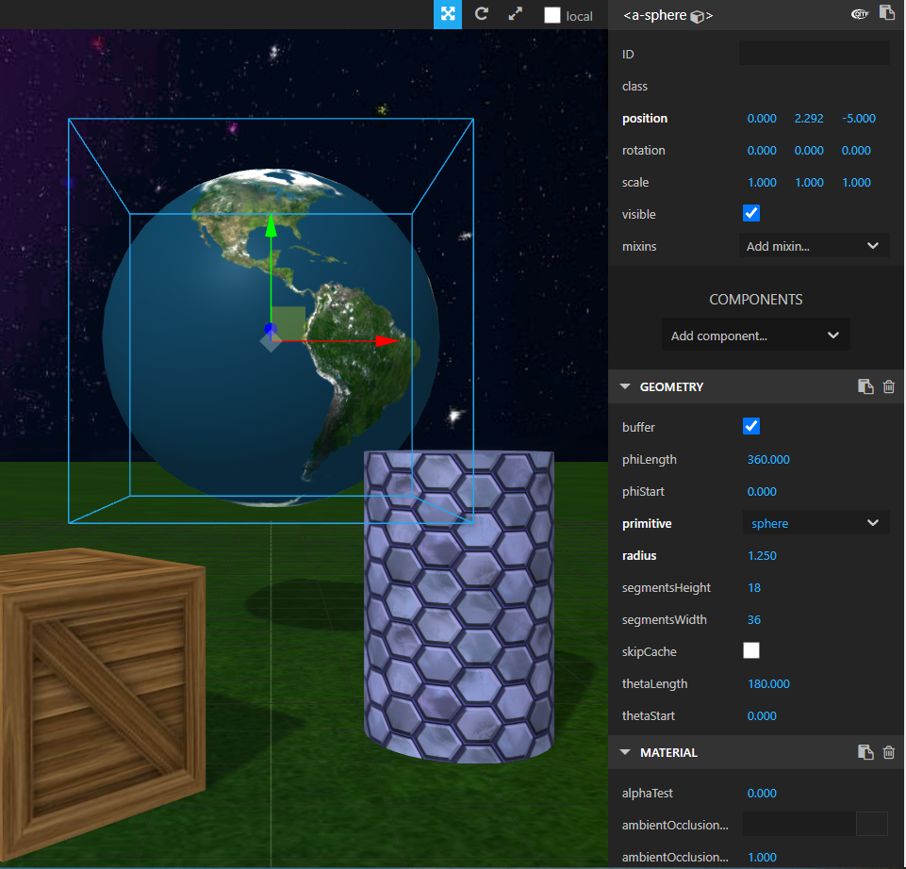
The menu on the right allows you to configure every property on every object.
It allows you to scale, rotate, change colors, lights, materials, etc.
It is VERY IMPORTANT to copy the properties that you like, to be able then to paste them again in your own files.

Slide 52
environment component

Slide 53
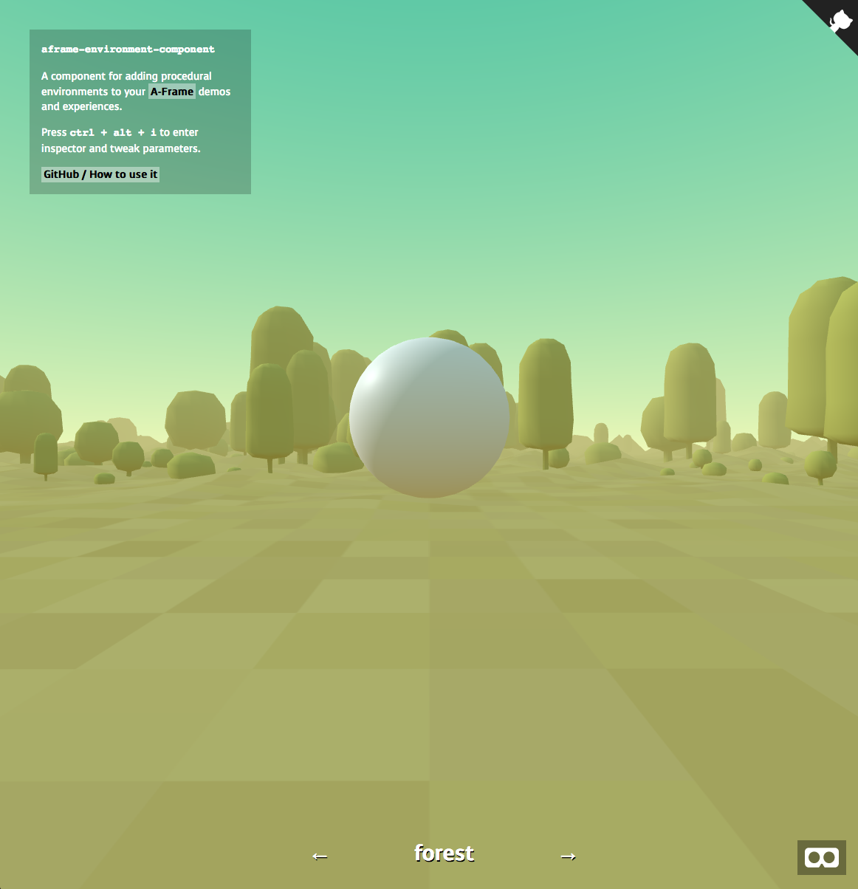
In order to start with the basics, A-frame comes with an extra component called environment, that allows us to create and customize an entire environment for us.

Slide 54
<head> <script src="js/aframe-environment-component.js"></script> </head> <body> <a-scene environment=”preset: forest;”> </a-scene> </body>
In order to use this feature we need to add another <script> tag to the <head> tag.
We then can add the property environment to the <a-scene> tag.
There are several preset values for environment: forest, goaland, contact, egypt, etc.
This creates a scene with floor, sky and some objects. And move around with wasd keys.

Slide 55

Try them out at
https://supermedium.github.io/aframe-environment-component/
Once you have chosen one, use the Inspector to tweak the properties around and adapt it to your scene.

Slide 56
Working Group Time

Slide 57
Start the webserver.
Go to a web browser and type “localhost/aframe/”.
The A-frame Examples page should run.
Go to your Computer and find the aframe folder.
Rename the file called environment.html to hackathon-group-X.html with the number of your group.
Create a new folder called hackathon-group-X with the number of your group.
All new objects and images must be downloaded in this folder.
How do we start the project on the computer for the hackathon?

Slide 58
Go to the environment component test page and browse through all the environments.
Choose the environment that will host your world.
Begin to make changes to adapt it to your scene. Remember to copy paste the configuration to your hackathon-group-x.html file.
Decide with your group, what other 3d objects do you need and search for them inside model folder or in Sketchfab
Begin to design on a piece of paper your future scene.
How do we begin the project as a group team?

Slide 59
2nd Workshop
Object component. 3D Builder. Animations

Slide 60
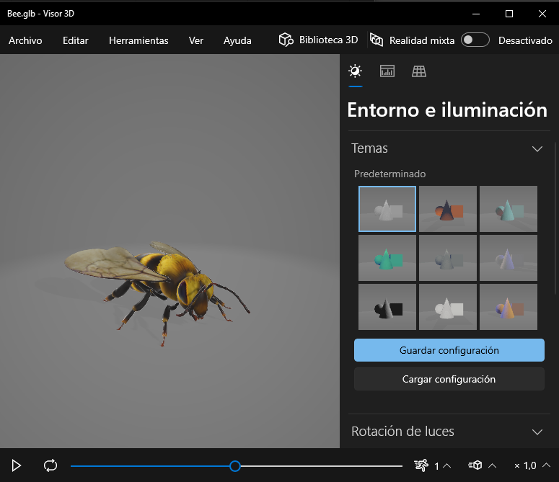
A model in 3D is just a set of data that represents an object in three dimensions.
There are different kinds of formats for 3D objects: obj, fbx, gltf, etc.
Sometimes an object is defined using more than just one file, like mtl files.
Basically, any 3d object gives information about all the points that define that 3d object, the more detailed the object is modelled, the more points it has.
# Exported from 3D Builder
o Object.1
v 2600.481445 2289.817383 8840.607422 255 255 255
v 3052.760742 3579.895996 9028.778320 255 255 255
v 2974.678223 3501.814453 9165.332031 255 255 255

Slide 61
Obj models are simpler, they has just the points information and color and optionally a mtl file with the information for the textures and materials.
Gltf (glb or glt) files are more complex, they offer also information about:
Hierarchical objects
Scene information (light sources, cameras)
Skeletal structure and animation
More robust materials and shaders
Other formats are possible, but safest is always obj and mtl.
# Exported from 3D Builder
o Object.1
v 2600.481445 2289.817383 8840.607422 255 255 255
v 3052.760742 3579.895996 9028.778320 255 255 255
v 2974.678223 3501.814453 9165.332031 255 255 255

Slide 62
<a-entity> tag

Slide 63
<a-assets>
<a-asset-item id="tree"
src="/path/to/tree.gltf">
</a-asset-item>
</a-assets>
<a-entity
gltf-model="#tree">
</a-entity>
In order to use gltf objects, they must be included as <a-assets> tag.
They need to have an unique id for identification.
This id will be used then at the <a-entity> tag for loading.
An <a-entity> tag works the same way as regular objects in terms of position, rotation, and scaling.

Slide 64
<a-assets>
<a-asset-item id="tree-obj"
src="/path/to/tree.obj">
</a-asset-item>
<a-asset-item id="tree-mtl"
src="/path/to/tree.mtl">
</a-asset-item>
</a-assets>
<a-entity
obj-model="obj: #tree-obj;
mtl: #tree-mtl">
</a-entity>
In order to use obj objects, they must be included as <a-assets> tag.
They need to have an unique id for identification.
This id will be used then at the <a-entity> tag for loading.
An <a-entity> tag works the same way as regular objects in terms of position, rotation, and scaling.
If an object has more than one file, all of them must be included in the <a-assets> tag and their ids must appear on the obj-model entity

Slide 65
3D Builder

Slide 66
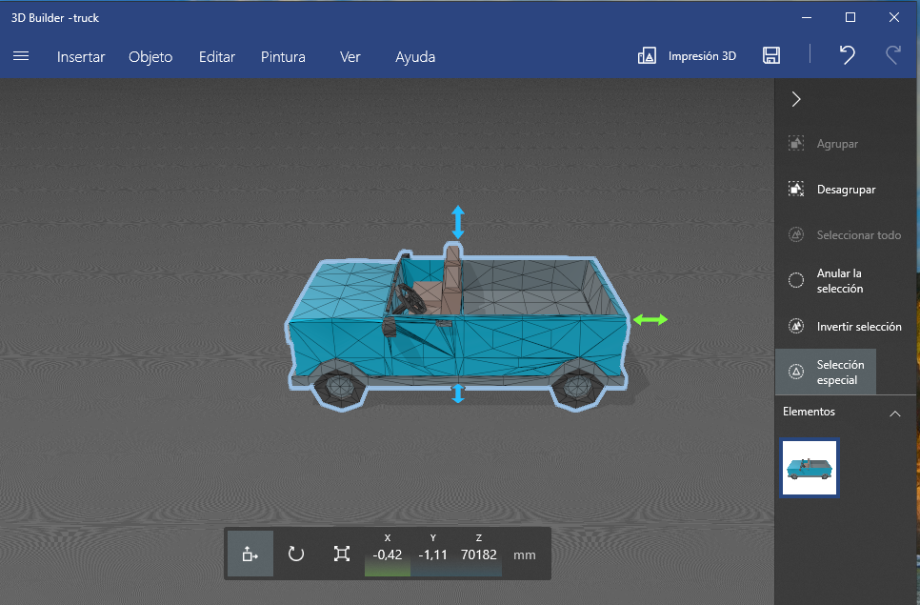
3D Builder is an application free for Windows, that edits 3d models.
It is primarily designed for 3d printing not for modeling but does makes it simpler to use.
On the top menu we have: Insert, Object, Edit, Paint, View and Help, Print and Save.
On the down menu we have: position, rotation and scale tools.

Slide 67
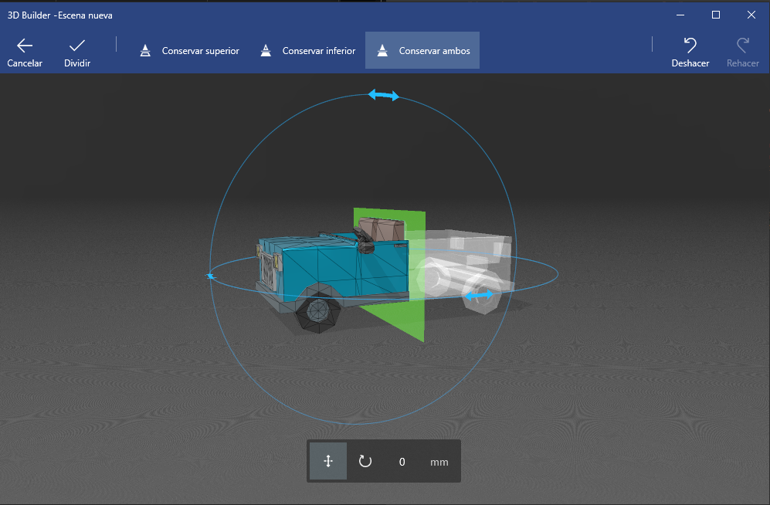
Insert: Allows to import more than one object.
Object: Allows us to copy, mirror or eliminate an object.
Edit: Allows us to split an object into two different objects and to combine them.
Paint: Allows us to modify the color and add textures to our objects.
Save: Allows us to export the new edited object into various 3d formats. Best option .gltf

Slide 68
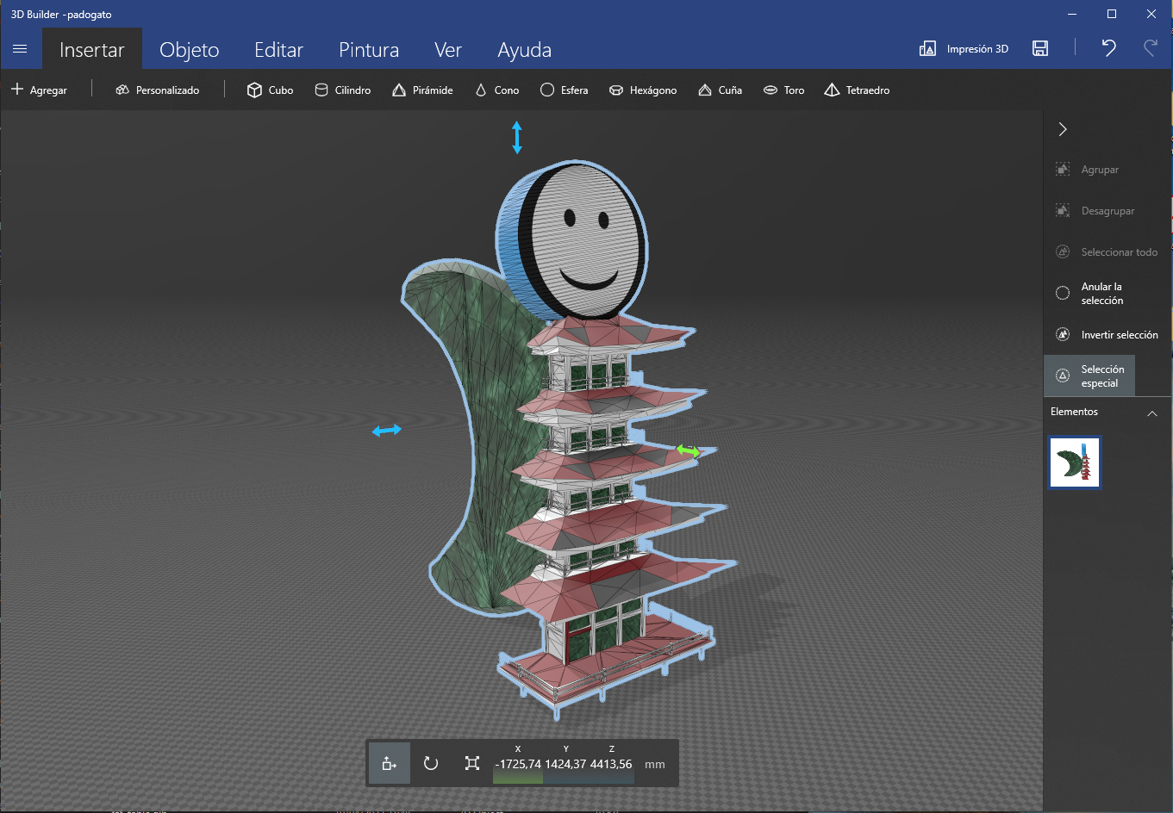
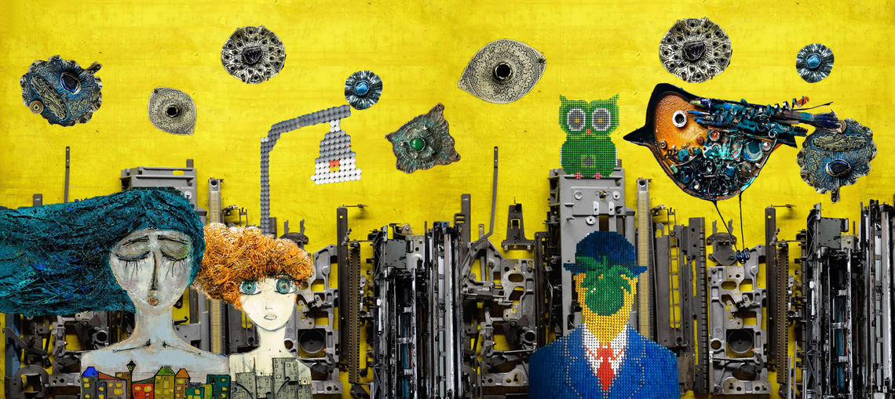
This options will provide us with the ability of combining different models to create new ones.
On the side image we can see a new model created via other models. It is the combination of a moon, a pagoda tower and a cylinder.
That is the idea of recycling the AI in the models. Recycled art is an aesthetic of its own.
Imagine There Is No Garbage by Kushane Chobanyan

Slide 69
Animation property

Slide 70
<a-box
position="-1 1.6 -5"
animation="
property: position;
to: 1 8 -10;
dur: 2000;
loop: true">
</a-box>
Animation is a property that can be added to an object or to an entity.
It allows to change values from its properties from an initial point to an end point, giving instructions about how long this transition last.
It can be given to a more than one property and more than one value at a time.
Not to confuse with the animation that an object can have in itself.

Slide 71
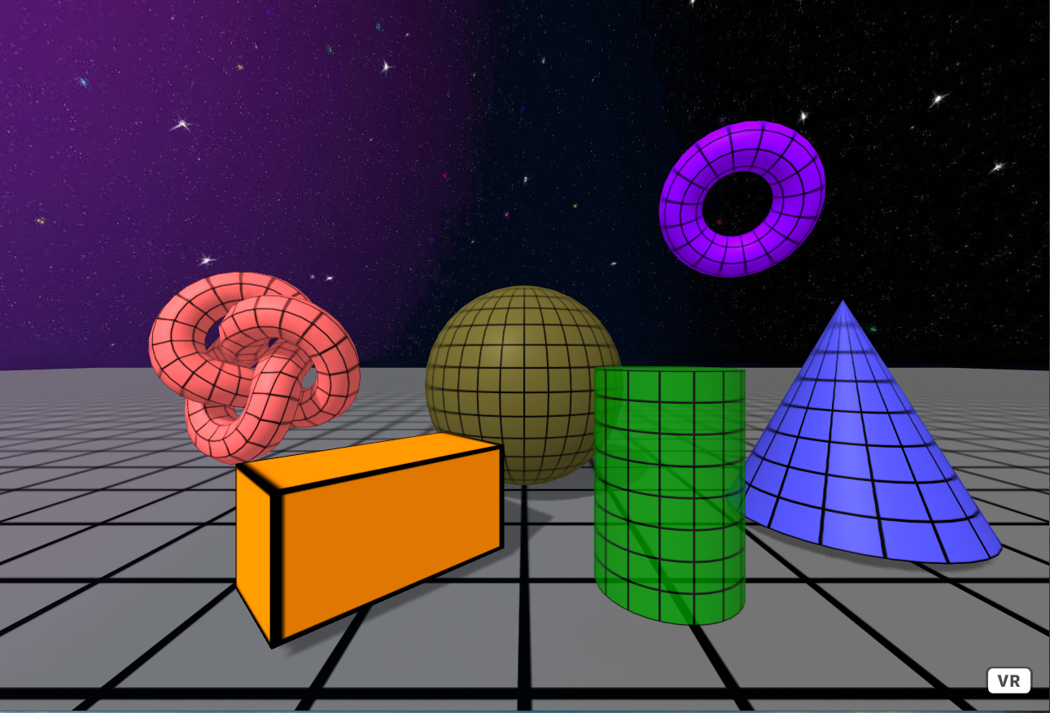
Its mains features are:
property: which property to animate, it could be position, rotation but color as well.
from: initial value.
to: final value.
dur: duration in milliseconds.
loop: how many repetitions, either a number or true for infinite.
delay: how many ms delay before begin the animation.
See https://aframe.io/docs/1.4.0/components/animation.html for more.

Slide 72
Working Group Time

Slide 73
Continue collecting your models.
Finish your scene design.
Begin importing your models into your scene.
Edit those models that are hard to find with 3D Builder.
Think of possible animations.
What is it expected from you at the end of the next working group session?

